Slide 1
肥宅下樓梯
Java Final Project Proposal
0410117 吳沛璇 2018.04

Slide 2
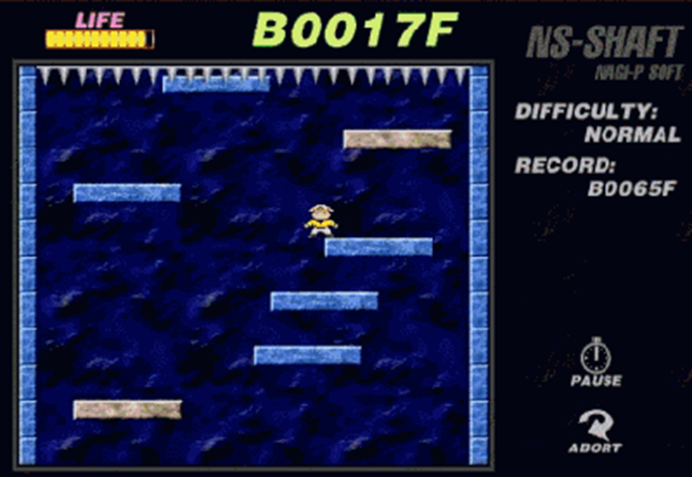
Outline
題目簡述
功能說明
架構(UML)
預期成果

Slide 3
用JAVA實作下樓梯遊戲
題
目
簡
述
類似電腦單機版的小朋友下樓梯
自己動手思考與實作完成
遊戲畫面
元件:
人物
背景
階梯與刺刀
排行榜
生命值
運作:
背景向上捲動
人物必須往下面的樓梯跳躍，才不會被刀刺

Slide 4
遊戲模式選取
功
能
說
明
Hard/Medium/Easy
One Player/Two Player
遊戲設定
基礎:
人物左右移動、背景畫面捲動正常
遊戲功能運作合理
進階:
請問你目前的體重? 理想體重? ->隨著樓層增加右側欄位漸漸達標 ->若瘦身有成，移動速度增加
新增欄位顯示瘦身成果
甩肉排行榜
兩個玩家

Slide 5
架構(UML)
-class name: KeyListener
+keyPressed(KeyEvent e)
+keyReleased(KeyEvent e)
-class name: Runnable
+run()
Relates to thread implementation.
Implements
-class name: Game
-private BufferedImage image、background -public enum STATE -Player p -Controller c -Health h
+start() +stop() +run() +init() +main() +render() +tick()
-class name: ImageLoader
-private BufferedImage image;
+public BufferedImage loadImage(String path)
-class name: Health
+addBlood() +subBlood() +getBlood() +setBlood()
Define figure’s blood.
-class name: Controler
-private LinkedList<Stair> s
+tick() +render() +addStair() +removeStair()
-class name: AnimateObject
Abstract class +setSpeed() +setPositon()
Import java.util.ArrayList;
-class name: Music
+playMusic(File music)
import javax.sound.sampled.*; import java.io.File;
Implements
-class name: Death
-recordButton -restartButton -quitButton
+render(Graphics g)
-class name: Stair
X_pos Y_pos Vertical_Speed Horizon_Speed
Player
-class name: Player
X_pos Y_pos Vertical_Speed
Stairs
-class name: MouseInput
+mouseClicked(MouseEvent e) +mouseEntered(MouseEvent e) +mouseExited(MouseEvent e)
+mousePressed(MouseEvent e) +mouseReleaseed(MouseEvent e)
-class name: MouseListener
-
Implements

Slide 6
-class name: KeyListener
+keyPressed(KeyEvent e)
+keyReleased(KeyEvent e)
-class name: Runnable
+run()
Relates to thread implementation.
Implements
-class name: Game
-private BufferedImage image、background -public enum STATE -Player p -Controller c -Health h
+start() +stop() +run() +init() +main() +render() +tick()
-class name: ImageLoader
-private BufferedImage image;
+public BufferedImage loadImage(String path)
-class name: Health
+addBlood() +subBlood() +getBlood() +setBlood()
Define figure’s blood.
-class name: Controler
-private LinkedList<Stair> s
+tick() +render() +addStair() +removeStair()
-class name: AnimateObject
Abstract class +setSpeed() +setPositon()
Import java.util.ArrayList;
-class name: Music
+playMusic(File music)
import javax.sound.sampled.*; import java.io.File;
-class name: P_Mode
-oneButton -twoButton
import java.awt.Color; import java.awt.Font; import java.awt.Graphics; import java.awt.Graphics2D; import java.awt.Rectangle;
-class name: Death
-recordButton -restartButton -quitButton
+render(Graphics g)
Implements
-class name: Stair
X_pos Y_pos Vertical_Speed Horizon_Speed
Player
-class name: Player
X_pos Y_pos Vertical_Speed
Stairs
-class name: MouseInput
+mouseClicked(MouseEvent e) +mouseEntered(MouseEvent e) +mouseExited(MouseEvent e)
+mousePressed(MouseEvent e) +mouseReleaseed(MouseEvent e)
-class name: Enemy
-bullet
+addBullet +removeBullet
-class name: Record
-exitButton
+render(Graphics g, Player p, Game game)
-class name: Music
+playMusic(File music)
import javax.sound.sampled.*; import java.io.File;
-class name: MouseListener
-
Implements

Slide 7
預期成果
This GIF ‘s reference: http://www.yystv.cn/p/1782

